Slide 1

Introduction to React
Lesson 01
Notes:
Add instructor notes here.

Slide 2
Lesson Objectives
At the end of this module you will
be able to:
Explain the importance of React.js
Virtual DOM
List advantages of React
Identify React environment setup and React CDN hosting
Notes:
Add instructor notes here.

Slide 3
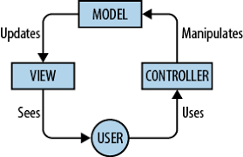
Javascript MVC
MVC offers architectural benefits over standard JavaScript — it helps you write better organized, and therefore more maintainable code.
MVC is composed of three components:
Model
View
Controller
Notes:
Model :
Model is where the application’s data objects are stored. The model doesn’t know anything about views and controllers. When a model changes, typically it will notify its observers that a change has occurred.
View
View is what's presented to the users and how users interact with the app. The view is made with HTML, CSS, JavaScript and often templates
Controller
The controller is the decision maker and the glue between the model and view. The controller updates the view when the model changes. It also adds event listeners to the view and updates the model when the user manipulates the view.
JavaScript now has a number of frameworks boasting support for MVC (or variations on it, which we refer to as the MV* family), allowing developers to easily add structure to their applications without great effort.
These frameworks include the likes of Backbone, Ember.js, and AngularJS.

Slide 4
React & SPA
Single-page apps are different from normal multi-page apps. The main difference between them is
Navigating a single-page app doesn't involve going to an entirely new page. Instead, loads the content within the same page itself.
For Implementing SPA we make use of Routing(React-Router)
Routing is where you try to map URLs to destinations that aren't physical pages such as the individual views in your single-page app.
Login Register Home Contact
Login Page
Regisrter
Form

Slide 5
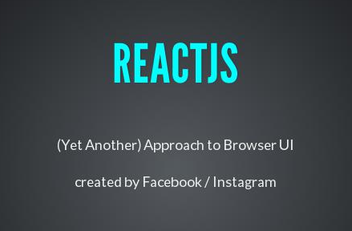
React: Introduction
It is an open source JavaScript library; components are defined and eventually become HTML
Developed by Facebook and Instagram
Intended to be the view("V") or the user interface in MVC
Aims at effortless development of a large scale Single Page Application (SPA)

Slide 6
React: Why React?
React code is easy to understand for developers, designers, and anyone with the knowledge of XML or HTML
It uses JSX which is clean and easy to understand syntax which can be used directly in our JavaScript
Easy to test
Renders quick views
Enforces good coding practices
Supported and used by Facebook
Notes:
Slide explains regarding the SOAP format

Slide 7
React: How React Renders the View?
JSX Code written describing the basic application
JSX is converted into JavaScript by the compiler
React turns converted JSX into a Virtual DOM
Virtual DOM is applied to Real DOM
Underlying Data Model is updated
React Updates Virtual DOM and then updates the real DOM in efficient Manner
Notes:
Add instructor notes here.

Slide 8
Getting Started – Installation Steps of React JS
Basic Setup
To get started with React, install the React CLI tool (Create React App) and run the command to create a new app:
npm install -g create-react-app
create-react-app my-app
cd my-app
npm start
You’ll need to have Node >= 6 on your machine.
Create-React-App : creates a frontend build pipeline, so you can use it with any backend you want.
Once created check for Package.json file inside application folder and move to the folder to start server

Slide 9
React: Advantages
Easy to know how a component is rendered just by look at the render function
JSX makes it easy to read the code of components. It is also easy to see the layout, or how components are plugged/combined with each other
Can be rendered on the server-side
Easy to test and integrated with tools like jest
Ensures readability and makes maintainability easier
Can be used with any framework like Backbone.js, Angular.js as it is only a view layer
Notes:
Add instructor notes here.

Slide 10
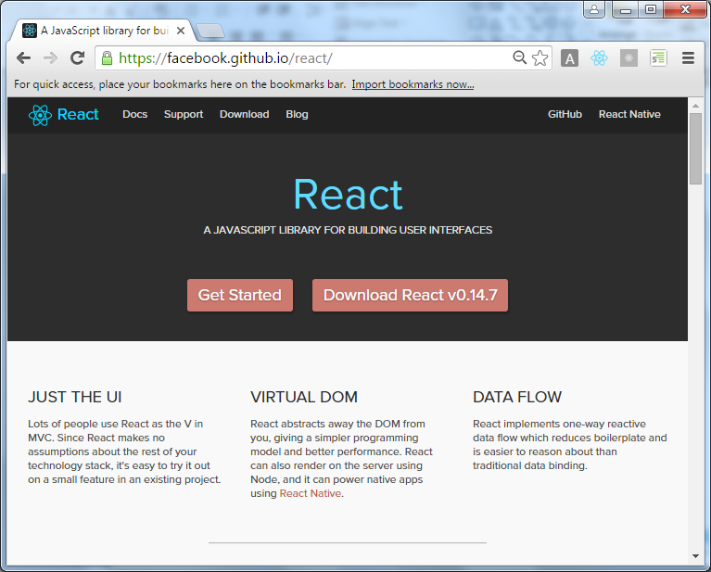
React Official Website

Slide 11
Hello-world application - Example
Create a new file index.html in the web project directory reactjs-example
Open up your Notepad++
Create a new file index.html & add the code below.
<!DOCTYPE html>
<html>
<head>
<title>React Basic</title></head>
<body>
<div id="root">
</div>
ReactDOM.render(<h1>Hello, world!</h1>,document.getElementById('root'));
</body>
</html>

Slide 12
Demo
React Hello World program
Notes:
Add the notes here.
Add instructor notes here.

Slide 13
Summary
Explain the importance of React.js
Virtual DOM
List advantages of React
Identify React environment setup and React CDN hosting
Notes:
Add the notes here.
Add instructor notes here.

Slide 14
Review Questions
Question 1:
_______is where you try to map URLs to destinations that aren't physical pages such as the individual views in your single-page app.
A) React
B) Route
C) Routing
D) Navigate
Question 2:
Which Command creates a frontend build pipeline, so you can use it with any backend you want.
A) React-App
B) create-react-app C) create-app D) React-app

